Slide 1
A Template

Slide 2

Topic

Slide 3
subtopic

Slide 4
A Slide
With text
and code

Slide 5

Your Turn
An exercise

Slide 8
























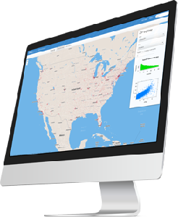
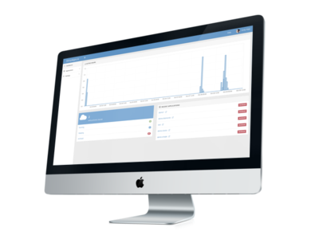























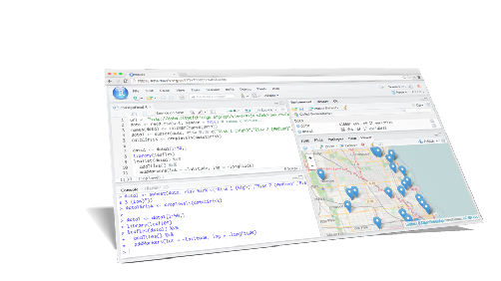
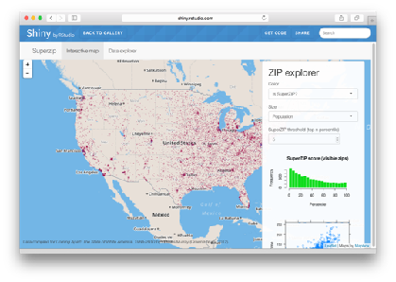






dplyr
0.4
+
SYSTEM LIBRARY

Slide 9





help
pressure | pressure | pressure | pressure
1007 | 1007 | 1007 | 1007
1009 | 1009 | 1009 | 1009
pressure | pressure | pressure
pressure | pressure | pressure
city | particle size | amount (µg/m³)
New York | large | 23
New York | small | 14
London | large | 22
London | small | 16
Beijing | large | 121
Beijing | small | 56
Country | 2011 | 2012 | 2013
FR | 7000 | 6900 | 7000
DE | 5800 | 6000 | 6200
US | 15000 | 14000 | 13000
Country
Count
Amount of large particulate
Amount of small particulate

Slide 10
storm | wind | pressure | date
Alberto | 110 | 1007 | 2000-08-12
Alex | 45 | 1009 | 1998-07-30
Allison | 65 | 1005 | 1995-06-04
Ana | 40 | 1013 | 1997-07-01
Arlene | 50 | 1010 | 1999-06-13
Arthur | 45 | 1010 | 1996-06-21
storm | pressure
Alberto | 1007
Alex | 1009
Allison | 1005
Ana | 1013
Arlene | 1010
Arthur | 1010
country | year | cases | pop
Afghanistan | 1999 | 745 | 19987071
Afghanistan | 2000 | 2666 | 20595360
Brazil | 1999 | 37737 | 172006362
Brazil | 2000 | 80488 | 174504898
China | 1999 | 212258 | 1272915272
China | 2000 | 213766 | 1280428583
date | wind | date | date
2000-08-12 | 110 | 2000-08-12 | 2000-08-12
1998-07-30 | 45 | 1998-07-30 | 1998-07-30
1880 | M | Garrett | 13
1997-07-01 | 40 | 1997-07-01 | 1997-07-01
1880 | M | Garrett | 13
1996-06-21 | 45 | 1996-06-21 | 1996-06-21
date | wind | date | date
1880 | M | Garrett | 13
1880 | M | Garrett | 13
storm | wind | pressure | date
Alberto | 110 | 1007 | 2000-08-12
M | M | M | M
Allison | 65 | 1005 | 1995-06-04
Ana | 40 | 1013 | 1997-07-01
Arlene | 50 | 1010 | 1999-06-13
M | M | M | M
storm | wind | pressure | date
Ana | 40 | 1013 | 1997-07-01
M | M | M | M
M | M | M | M
Arlene | 50 | 1010 | 1999-06-13
Allison | 65 | 1005 | 1995-06-04
Alberto | 110 | 1007 | 2000-08-12
storm | wind | pressure | date
Alberto | 110 | 1007 | 2000-08-12
Alex | 45 | 1009 | 1998-07-30
Allison | 65 | 1005 | 1995-06-04
Ana | 40 | 1013 | 1997-07-01
Arlene | 50 | 1010 | 1999-06-13
Arthur | 45 | 1010 | 1996-06-21
Allison | Allison
13 | 13
storm | wind | pressure | date
Alberto | 110 | 1007 | 2000-08-12
Alex | 45 | 1009 | 1998-07-30
Allison | 65 | 1005 | 1995-06-04
Ana | 40 | 1013 | 1997-07-01
Arlene | 50 | 1010 | 1999-06-13
Arthur | 45 | 1010 | 1996-06-21
storm | wind | pressure | date | ratio
Alberto | 110 | 1007 | 2000-08-12 | 9.15
Alex | 45 | 1009 | 1998-07-30 | 22.42
Allison | 65 | 1005 | 1995-06-04 | 15.46
Ana | 40 | 1013 | 1997-07-01 | 25.32
Arlene | 50 | 1010 | 1999-06-13 | 20.20
Arthur | 45 | 1010 | 1996-06-21 | 22.44

Slide 11
country | r.squared | data | model
Botswana | 0.03
Lesotho | 0.08
Rwanda | 0.02
year | .resid
1952 | -5.3071154
1957 | -3.6144580
1962 | -2.0158007
1967 | -0.5411434
1972 | 1.8815140
1977 | 4.8731713
1982 | 6.7348287
1987 | 8.5694860
1992 | 7.3891434
1997 | -3.1031993
2002 | -9.3285420
2007 | -5.5378846
Call:
lm(formula = lifeExp ~ year, data = .)
Coefficients:
(Intercept) year
-65.49586 0.06067
year | .resid
1952 | -5.2410256
1957 | -2.8098543
1962 | -0.5876830
1967 | -0.3205117
1972 | 0.4766597
1977 | 2.4398310
1982 | 4.8320023
1987 | 6.4561737
1992 | 8.4833450
1997 | 3.8785163
2002 | -7.5643124
2007 | -10.0431410
Call:
lm(formula = lifeExp ~ year, data = .)
Coefficients:
(Intercept) year
-139.16529 0.09557
year | .resid
1952 | -2.7419487
1957 | -1.0127914
1962 | 0.7163660
1967 | 2.0455233
1972 | 2.7746807
1977 | 3.4038380
1982 | 4.8509953
1987 | 2.8821527
1992 | -17.3096900
1997 | -4.5925326
2002 | 2.9626247
2007 | 6.0207821
Call:
lm(formula = lifeExp ~ year, data = .)
Coefficients:
(Intercept) year
-139.16529 0.09557

